Slide 1
UNIT 4: SEQUENTIAL CIRCUITS
II Year
AIML, BDA

Slide 2
UNIT 4: SEQUENTIAL CIRCUITS
Sequential circuits,
Latch and Flip-Flops,
RS Flip-Flops,
Gated Flip-Flops,
Edge-triggered RS FLIP-FLOP,
Edge-triggered D FLIP-FLOPs,
Edge-triggered T FLIP-FLOPs,
Edge-triggered JK FLIPFLOPs,
JK Master-slave FLIP-FLOP,
Analysis of Synchronous Sequential Circuit,
State Equation, State table, State Diagram,
Synthesis of sequential circuit using Flip-Flops,
Asynchronous sequential circuit,
Transition Table, State table ,
Flow table,
Analysis of asynchronous sequential circuits

Slide 3


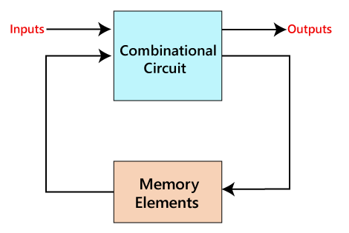

SEQUENTIAL CIRCUITS
The sequential circuit is a special type of circuit that has a series of inputs and outputs.
The outputs of the sequential circuits depend on both the combination of present inputs and previous outputs.
The previous output is treated as the present state. So, the sequential circuit contains the combinational circuit and its memory storage elements.
The sequential circuit can contain only the memory element.

Slide 4
S. No. | Combinational Circuits | Sequential Circuits
1) | The outputs of the combinational circuit depend only on the present inputs. | The outputs of the sequential circuits depend on both present inputs and present state(previous output).
2) | The feedback path is not present in the combinational circuit. | The feedback path is present in the sequential circuits.
3) | In combinational circuits, memory elements are not required. | In the sequential circuit, memory elements play an important role and require.
4) | The clock signal is not required for combinational circuits. | The clock signal is required for sequential circuits.
5) | The combinational circuit is simple to design. | It is not simple to design a sequential circuit.

Slide 5
Types of Sequential Circuits
Following are the two types of sequential circuits
Asynchronous sequential circuits
Synchronous sequential circuits

Slide 6
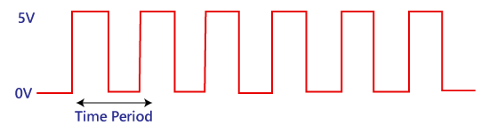
Clock Signal and Triggering
Clock signal

Slide 7
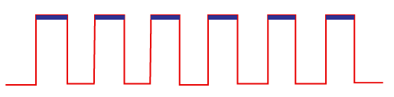
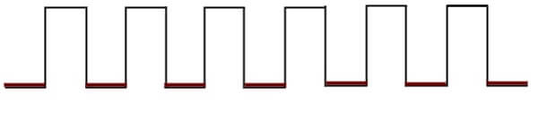
Types of Triggering
Positive level triggering
Negative level triggering

Slide 8
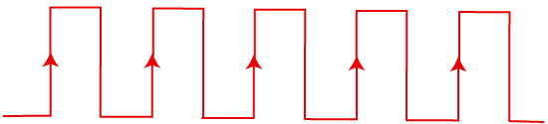
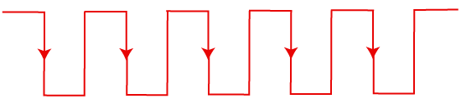
Edge triggering
Positive edge triggering
Negative edge triggering

Slide 9
Latch and Flip-Flops
There are two types of memory elements based on the type of triggering that is suitable to operate it.
Latches
Flip-flops
Latches operate with enable signal, which is level sensitive.
Whereas, flip-flops are edge sensitive.

Slide 10
Flip Flops
A circuit that has two stable states is treated as a flip flop.
These stable states are used to store binary data that can be changed by applying varying inputs.
The flip flops are the fundamental building blocks of the digital system. Flip flops and latches are examples of data storage elements.
In the sequential logical circuit, the flip flop is the basic storage element. The latches and flip flops are the basic storage elements but different in working.
There are the following types of flip flops:

Slide 11
Flip Flops
There are the following types of flip flops:
RS Flip-Flops,
Gated Flip-Flops
Edge-triggered RS FLIP-FLOP
Edge-triggered D FLIP-FLOPs
Edge-triggered T FLIP-FLOPs
Edge-triggered JK FLIPFLOPs
JK Master-slave FLIP-FLOP

Slide 12
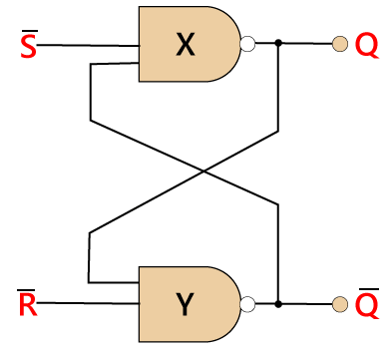
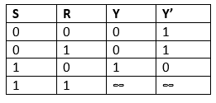
















RS Latch

Slide 13
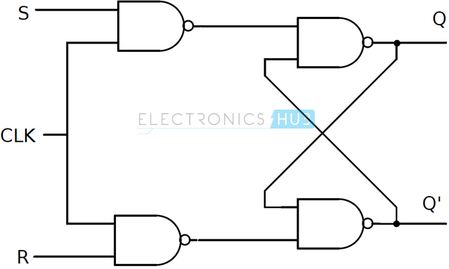











Gated Flip Flop

Slide 14









Gated Flip Flop

Slide 15
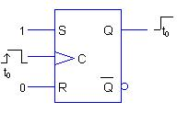
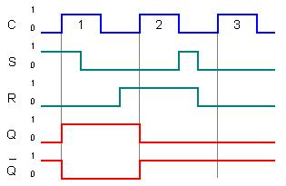
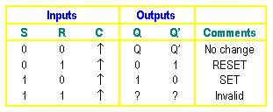
Edge-triggered RS FLIP-FLOP
As S = 1, R = 0. Flip-flop SETS on the rising clock edge.

Slide 16




Edge-triggered D flip-flop
The operations of a D flip-flop is much simpler.
It has only one input addition to the clock.
It is very useful when a single data bit (0 or 1) is to be stored. If there is a HIGH on the D input when a clock pulse is applied, the flip-flop SETs and stores a 1.
If there is a LOW on the D input when a clock pulse is applied, the flip-flop RESETs and stores a 0. The truth table below summarize the operations of the positive edge-triggered D flip-flop.
D flip flop is a widely used flip flop in digital systems. The D flip flop is mostly used in shift-registers, counters, and input synchronization.

Slide 17
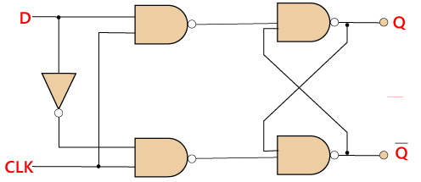
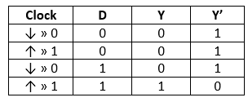


Edge-triggered D flip-flop

Slide 18
Edge-triggered JK FLIPFLOPs
The JK flip flop is used to remove the drawback of the S-R flip flop, i.e., undefined states.
The JK flip flop is formed by doing modification in the SR flip flop.
The S-R flip flop is improved in order to construct the J-K flip flop.
When S and R input is set to true, the SR flip flop gives an inaccurate result. But in the case of JK flip flop, it gives the correct output.

Slide 19
Edge-triggered JK FLIPFLOPs
In J-K flip flop, if both of its inputs are different, the value of J at the next clock edge is taken by the output Y.
If both of its input is low, then no change occurs, and if high at the clock edge, then from one state to the other, the output will be toggled.
The JK Flip Flop is a Set or Reset Flip flop in the digital system.

Slide 20
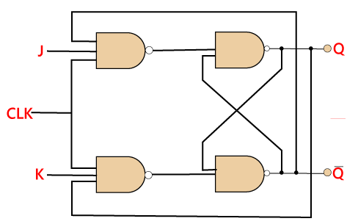













Slide 21
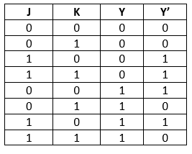
Edge-triggered JK FLIPFLOPs

Slide 22
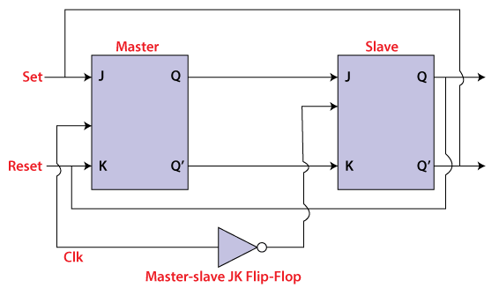
JK Master-slave FLIP-FLOP
In "JK Flip Flop", when both the inputs and CLK set to 1 for a long time, then Q output toggle until the CLK is 1. Thus, the uncertain or unreliable output produces. This problem is referred to as a race-around condition in JK flip-flop and avoided by ensuring that the CLK set to 1 only for a very short time.

Slide 23
JK Master-slave FLIP-FLOP - WORKING
When the clock pulse is true, the slave flip flop will be in the isolated state, and the system's state may be affected by the J and K inputs. The "slave" remains isolated until the CP is 1. When the CP set to 0, the master flip-flop passes the information to the slave flip flop to obtain the output.
The master flip flop responds first from the slave because the master flip flop is the positive level trigger, and the slave flip flop is the negative level trigger.
The output Q'=1 of the master flip flop is passed to the slave flip flop as an input K when the input J set to 0 and K set to 1. The clock forces the slave flip flop to work as reset, and then the slave copies the master flip flop.
When J=1, and K=0, the output Q=1 is passed to the J input of the slave. The clock's negative transition sets the slave and copies the master.
The master flip flop toggles on the clock's positive transition when the inputs J and K set to 1. At that time, the slave flip flop toggles on the clock's negative transition.
The flip flop will be disabled, and Q remains unchanged when both the inputs of the JK flip flop set to 0.

Slide 24
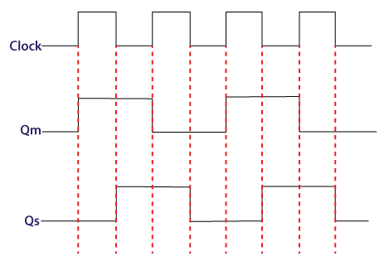
JK Master-slave FLIP-FLOP - WORKING
When the clock pulse set to 1, the output of the master flip flop will be one until the clock input remains 0.
When the clock pulse becomes high again, then the master's output is 0, which will be set to 1 when the clock becomes one again.
The master flip flop is operational when the clock pulse is 1. The slave's output remains 0 until the clock is not set to 0 because the slave flip flop is not operational.
The slave flip flop is operational when the clock pulse is 0. The output of the master remains one until the clock is not set to 0 again.
Toggling occurs during the entire process because the output changes once in the cycle.

Slide 25
Edge-triggered T FLIP-FLOPs
In T flip flop, there is only single input with the clock input.
The T flip flop is constructed by connecting both of the inputs of JK flip flop together as a single input.
The T flip flop is also known as Toggle flip-flop. These T flip-flops are able to find the complement of its state.

Slide 26
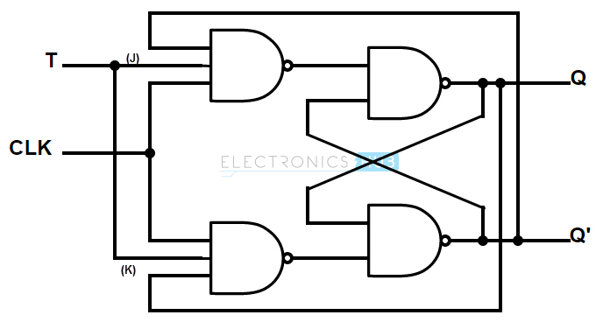












Edge-triggered T FLIP-FLOPs

Slide 27
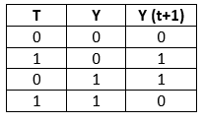
Edge-triggered T FLIP-FLOPs

